Slide 1
Angular Upskilling Program
Templates & Component
Communication Basics

Slide 2
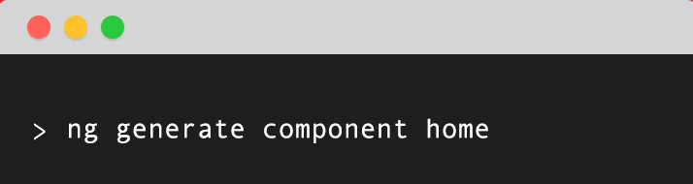
Create a component using Angular CLI

Slide 3
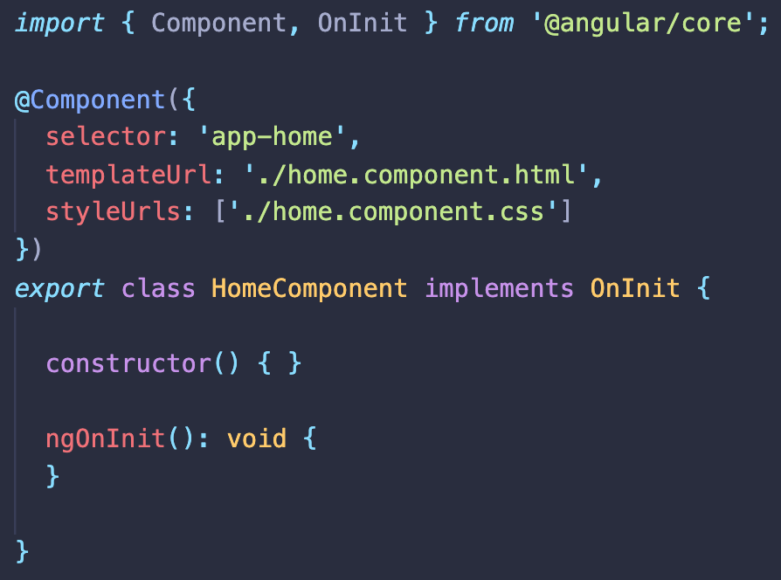
Angular Components - Structure
An angular component is structured into three parts:
- Controller (.ts file)
- Template (inline or separate .html file)
- Styles (inline or separate .css file)

Slide 4

Templates and Data Binding

Slide 5
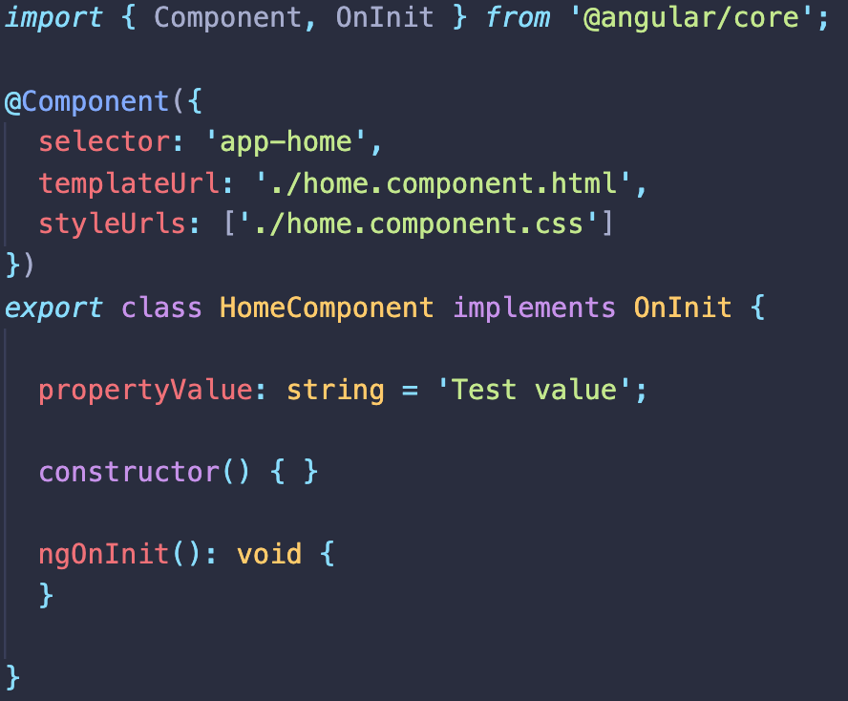
One way data binding – From Component to Template

Slide 6
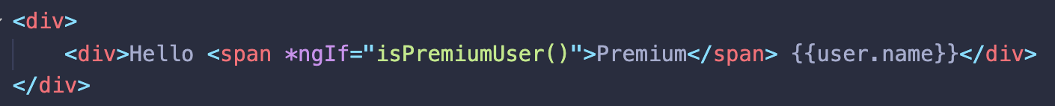
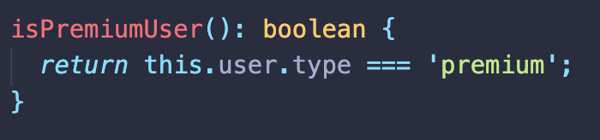
Built-in Directives – Conditional Rendering => *ngIf
NgIf directive when you want to display an element based on a condition;
How to use?

Slide 7
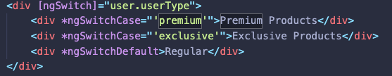
Built-in Directives – Conditional Rendering ngSwitch
It is using the same principle as *ngIf directive. Prefered to use if ther rendering condition covers more than 2 cases.
How to use?
Note: Be careful that the values taken by *ngSwitchCases must be primitives. If you are not treating them as primitives the compiler will consider that you’ve done data binding.

Slide 8
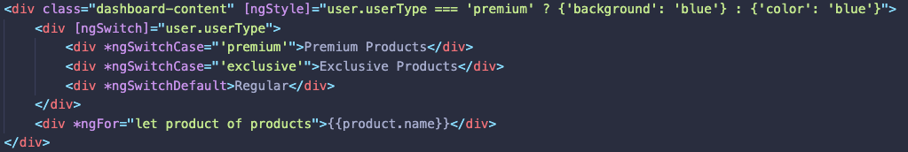
Built-in Directives – Dynamic Styling ngStyle
[ngStyle] directive is an attribute directive that can apply styling based on one or multiple conditions.
How to use?
Note: When using functions that binds with ngStyle directive, the function must exist in the component, otherwise you will get an error and the dynamic block will not be rendered.

Slide 9
Template Bindings
Binding Type | Target | Example
Property | Element property | Each classic attribute of HTML elements wrapped in square brackets. Example: <img [src]=“imgSource”[alt]=“myImageAlt” /> When the template will be compiled into view the Angular Compiler will look into the component where the template is attached for imgSource and myImageAlt properties.
 | Component Property | Developers can pass data to components from a parent component by using the @Input() decorator; Example: <my-component [data]=“products”></my-component> In this case the Angular Compiler will look for products property in the parent component and bind it to the property annotated with @Input() and name data.
 | Directive Property | When a built in or custom directive is used the its name should be wrapped in square brackets. Example: <div [ngStyle]=“applyCustomStyle()”> <h1>Hello</h1> </div> In this case the Angular Compiler will look in the component for applyCustomStyle function and apply it’s returned value.

Slide 10
Template Bindings
Binding Type | Target | Example
Event | Element property | Each available browser event wrappend in round paranthesis: Example: <input type=“text” (change)=“handleOnChange($event)”/> When the onChange event is triggered by user input Angular will look into the component for handleOnChange event handler.
 | Component Property | Developers can pass data to components from a child component to parent by using the @Output() decorator; Example: <my-component (onAdd)=“onItemAdded($event)”></my-component> In this case the Angular Compiler will look for onItemAdded property in the parent component and bind it as an event handler when the onAdd event was emitted.
 | Directive Property | When a built in or custom directive is used the its name should be wrapped in square brackets. Example: <input type=“text” [(ngModel)]=“productName” /> In this case the Angular Compiler will look in the component for productName property and will add two way data binding behavior.

Slide 11
Component Communication & Reusable Components

Slide 12
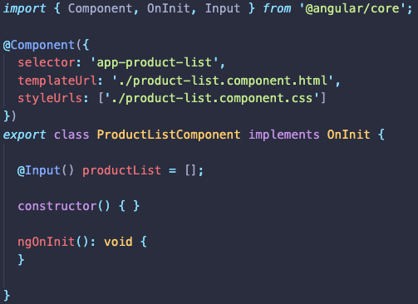
@Input & @Output Decorators
@Input decorator – used to pass data from Parent Component to Child Component;

Slide 13
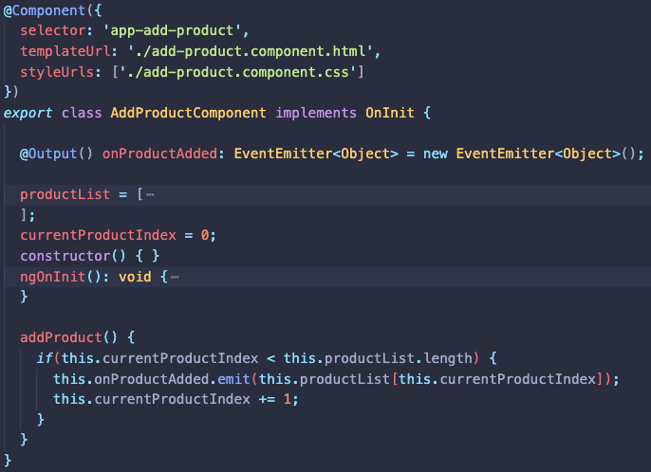
@Input & @Output Decorators
@Output decorator – used to pass data from Child Component to Parent Component;

Slide 14
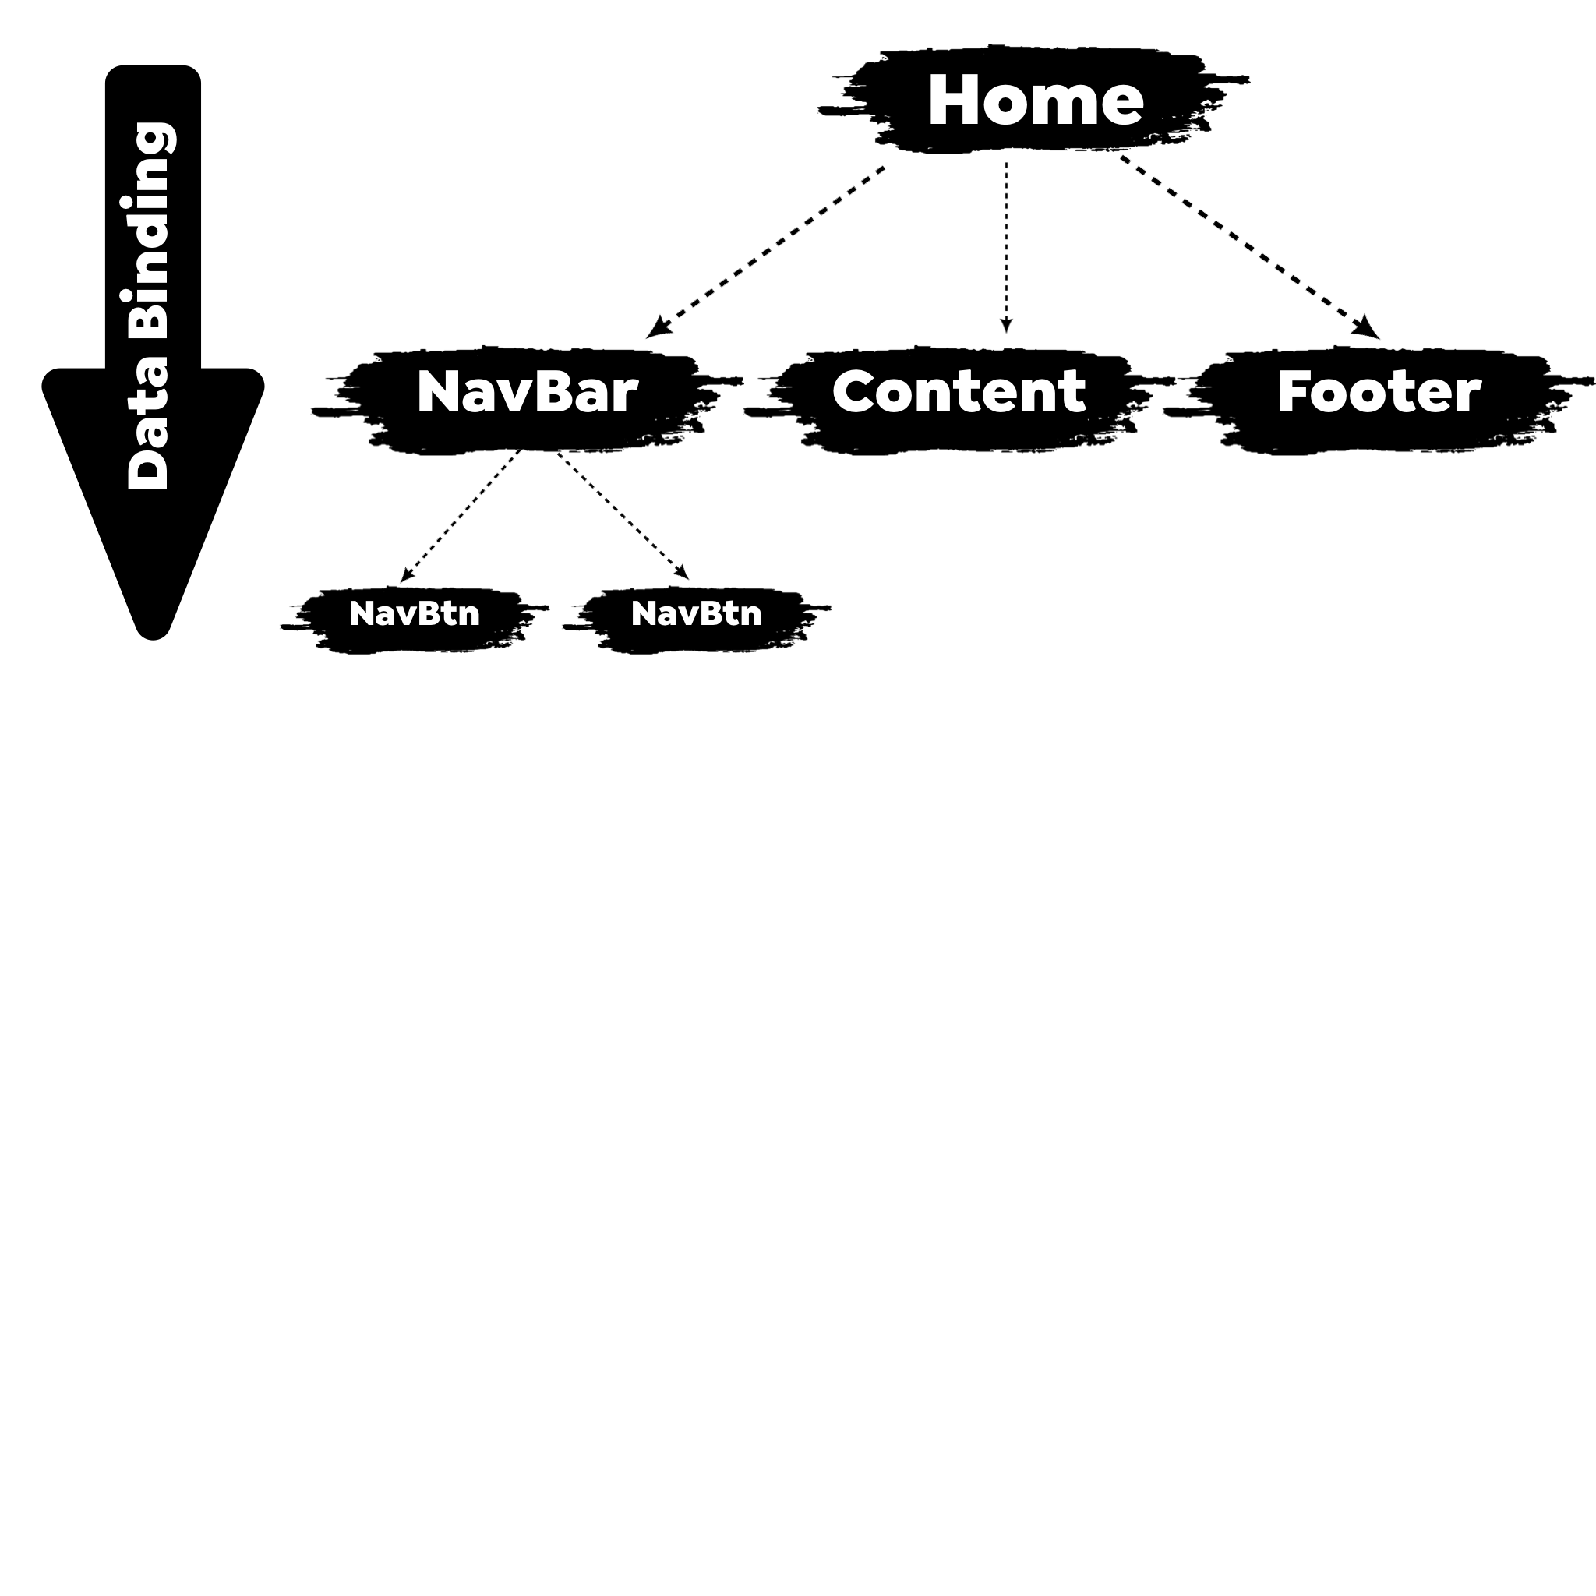
Component Tree and Data binding

Slide 15
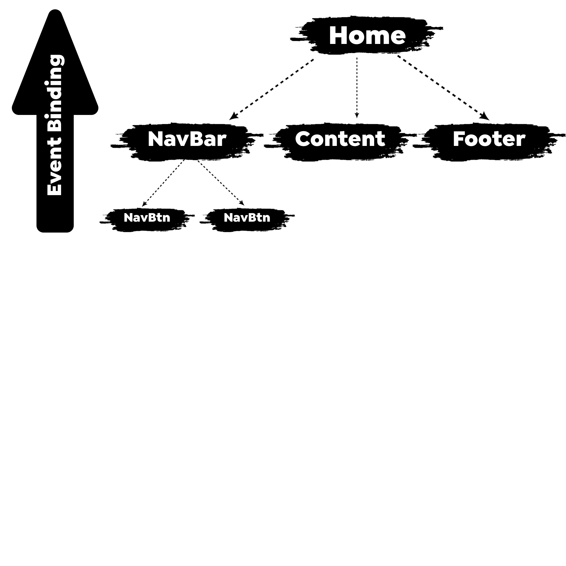
Component Tree and Event Binding

Slide 16


